Slide 1


Predictive Performance of CSF Aβ₁₋₄₂ and Tau for Cognitive Decline and Progression to Dementia
Leslie M Shaw
Perelman School of Medicine
University of Pennsylvania

Slide 2
Analysis of 2401 ADNI1/GO/2 CSF samples
2401 (1221 BASELINE + 1180 longitudinal) ADNI pristine CSFs, collected from 9/7/2005 to 7/25/2016 were analyzed in 36 analytical runs at UPenn from 11-17-2016 to 1-20-2017:
ADNI Phase | HC | SMC | EMCI | LMCI | AD
 | 1221 BASELINE ADNI CSFs
ADNI 1 | 112 | -- | -- | 192 | 98
ADNIGO/2 | 160 | 96 | 277 | 154 | 132

Slide 3
Analyses of ADNI1/GO/2 CSF Aβ₁₋₄₂, t-tau, p-tau₁₈₁ using the Roche Elecsys fully automated immunoassay platform
At our previous ADNI meeting the following were described.
Rationale for moving from RUO to full automation
Validation of Aβ₁₋₄₂ for precision, accuracy, and clinical performance
General statistics for Aβ₁₋₄₂, t-tau, p-tau₁₈₁, t-tau/Aβ₁₋₄₂, p-tau₁₈₁/Aβ₁₋₄₂ in the ADNI1/GO/2 CSF samples
Histogram distributions for Aβ₁₋₄₂, t-tau/Aβ₁₋₄₂, p-tau₁₈₁
Distributions based on FBP amyloid-β PET + or –
Cutpoint determinations
Collaborative study with BioFINDER
Concordance with FBP amyloid-β PET
Prediction of cognitive decline(CDRsob)
Assessments of the contribution of CSF t-tau and p-tau₁₈₁ to the clinical utility of CSF Aβ₁₋₄₂

Slide 4
ADNI1 BASELINE CSF Aβ₁₋₄₂, t-tau, p-tau₁₈₁& ratios
ADNI1 | Aβ₁₋₄₂ | t-tau | p-tau₁₈₁ | t-tau/Aβ₁₋₄₂ | p-tau₁₈₁/Aβ₁₋₄₂ | % ε4+
 | (pg/mL) | (pg/mL) | (pg/mL)
AD |  |  |  |  |  | 70.4
Median | 558 | 349 | 34 | 0.61 | 0.063
N=98 mean±SD | 659±375 | 359±130 | 36±15 | 0.64±0.29 | 0.065±0.033
95% CI | 306-1663 | 154-687 | 13-73 | 0.15-1.40 | 0.012-0.14
MCI |  |  |  |  |  | 54.1
Median | 658 | 294 | 28 | 0.48 | 0.048
N=192 mean±SD | 846±482 | 312±124 | 31±14 | 0.51±0.30 | 0.049±0.033
95% CI | 293-2041 | 140-599 | 12-63 | 0.12-1.13 | 0.010-0.13
NC |  |  |  |  |  | 24.1
Median | 1239 | 218 | 20 | 0.18 | 0.015
N=111 mean±SD | 1246±647 | 239±84 | 22±9 | 0.27±0.18 | 0.023±0.018
95% CI | 401-2742 | 112-444 | 11-43 | 0.11-0.73 | 0.0089-0.075

Slide 5
ADNIGO/2 CSF BASELINE Aβ₁₋₄₂, t-tau, p-tau₁₈₁ & ratios
ADNIGO/2 | Aβ₁₋₄₂ | t-tau | p-tau₁₈₁ | t-tau/Aβ₁₋₄₂ | p-tau₁₈₁/Aβ₁₋₄₂ | % ε4+
 | (pg/mL) | (pg/mL) | (pg/mL)
AD Median | 594 | 334 | 33 | 0.57 | 0.058 | 66.7
N=132 mean±SD | 649±257 | 375±155 | 37±16 | 0.62±0.33 | 0.062±0.034
95% CI | 309-1375 | 170-750 | 15-76 | 0.14-1.41 | 0.012-0.15
LMCI Median | 793 | 286 | 28 | 0.39 | 0.037 | 57.1
N=154 mean±SD | 936±494 | 308±136 | 30±15 | 0.41±0.25 | 0.041±0.023
95% CI | 342-2275 | 115-577 | 10-63 | 0.1-0.98 | 0.0078-0.099
EMCI Median | 1052 | 234 | 20 | 0.20 | 0.017 | 42.2
N=277 mean±SD | 1178±588 | 256±122 | 24±14 | 0.29±0.25 | 0.028±0.028
95% CI | 395-2431 | 117-582 | 10-67 | 0.09-0.94 | 0.0077-0.103
SMC Median | 1324 | 218 | 19 | 0.15 | 0.013 | 34.4
N=96 mean±SD | 1364±612 | 241±94 | 22±10 | 0.22±0.15 | 0.020±0.015
95% CI | 466-2691 | 107-462 | 10-49 | 0.09-0.62 | 0.0081-0.0653
NC Median | 1285 | 211 | 19 | 0.15 | 0.013 | 26.9
N=160 mean±SD | 1384±667 | 238±92 | 22±9 | 0.22±0.16 | 0.021-0.028
95% CI | 421-2697 | 110-469 | 10-48 | 0.09-0.68 | 0.0076-0.0698

Slide 6
Aβ₁₋₄₂ all values
1239
1285
1324
1052
658
793*
558
594
Numbers inside the boxes are the respective median values for BL Aβ₁₋₄₂ in pg/mL placed above the median value horizontal line.
*p<0.005 for LMCI ADNIGO+2 vs ADNI1; p=0.11 for NL ADNIGO+2 vs ADNI1; p=0.23 for AD ADNIGO+2 vs ADNI1

Slide 7
t-tau
349
334
294
286
218
211
218
234
Numbers inside the boxes are the respective median values for BL t-tau in pg/mL placed above the median value horizontal line.
P=0.81 for NL ADNIGO+2 vs ADNI1; p=0.51 for MCI ADNIGO+2 vs ADNI1; p=0.81 for AD ADNIGO+2 vs ADNI1

Slide 8
p-tau₁₈₁
34.0
33.2
28.4
27.6
19.9
20.0
19.3
19.3
Numbers inside the boxes are the respective median values for p-tau₁₈₁ in pg/mL placed above the median value horizontal line.
*p=0.71 for ADNIGO+2 vs ADNI1; p=0.43 for MCI ADNIGO+2 vs ADNI1; p=0.88 for AD ADNIGO+2 vs ADNI1.

Slide 9
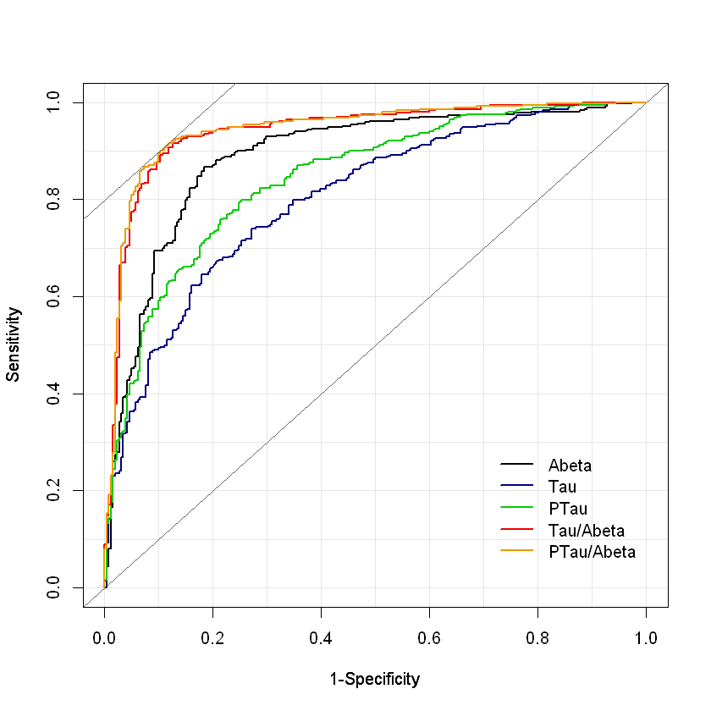
ROC Curves for SMC+EMCI+LMCI+AD CSF biomarkers using FBP PET+/- as the clinical endpoint
In the ADNI study*
AUC values: Sens Spec Eff
p-tau/Aβ₁₋₄₂ 0.944 91.3% 88.5% 90.2%
t-tau/Aβ₁₋₄₂ 0.940 91.6% 87.4% 89.9%
Aβ₁₋₄₂ 0.889 86.7% 81.7% 84.6%
p-tau₁₈₁ 0.845 79.9% 74.8% 77.8%
t-tau 0.803 74.0% 72.9% 73.5%
Cutpoint values:
p-tau/Aβ₁₋₄₂ 0.021
t-tau/Aβ₁₋₄₂ 0.222
Aβ₁₋₄₂ 980 pg/mL
p-tau₁₈₁ 21.8 pg/mL
t-tau 245 pg/mL
2017 ADNI dataset included in the collaboration
with the Swedish BioFINDER study
*SUVR of 1.1 used: Landau and Jagust

Slide 10
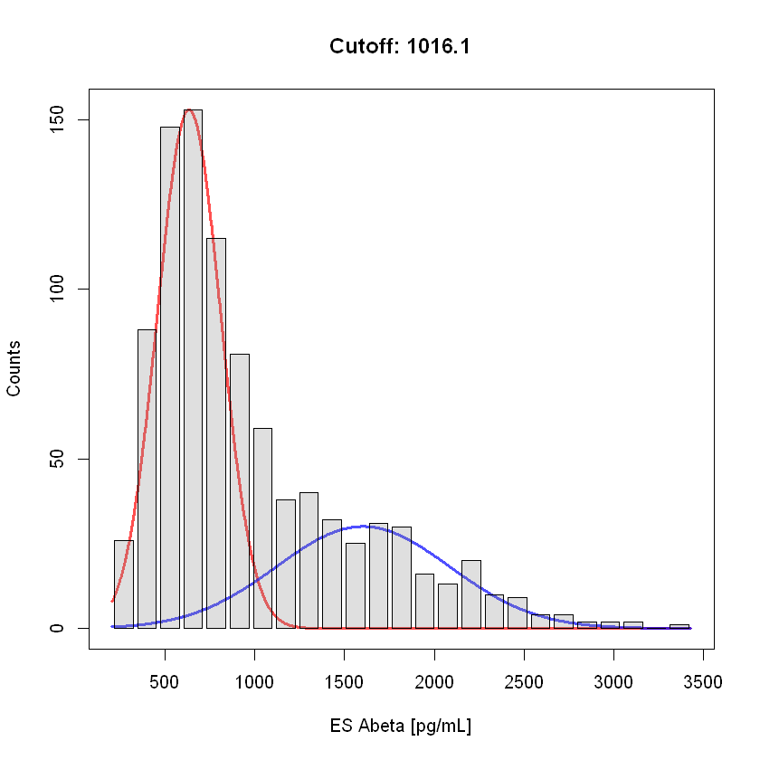
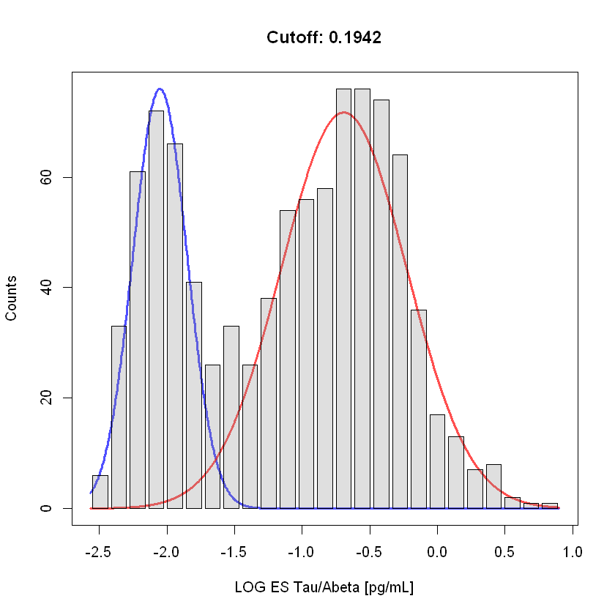
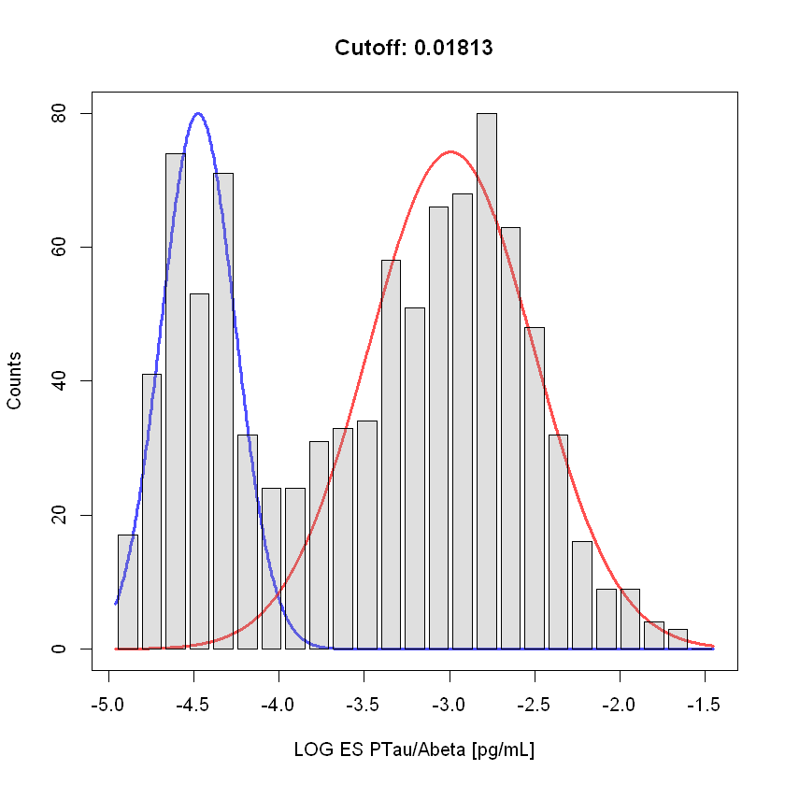
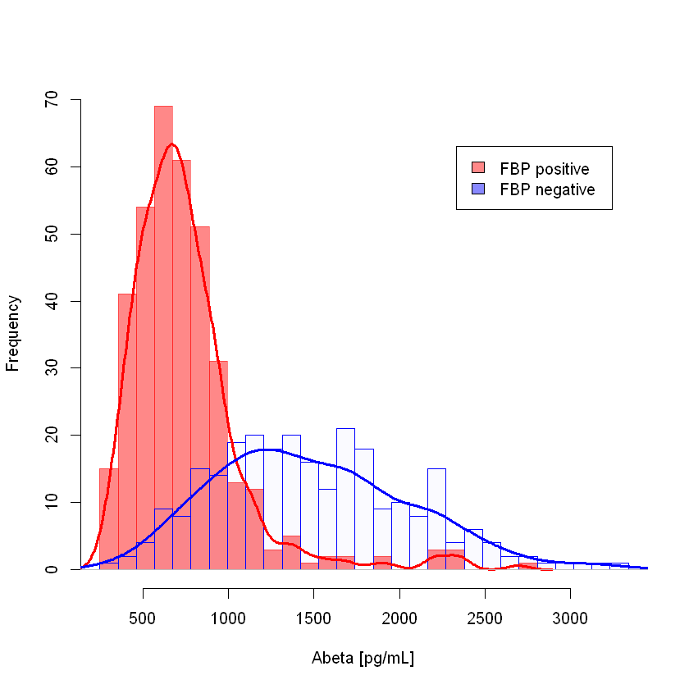
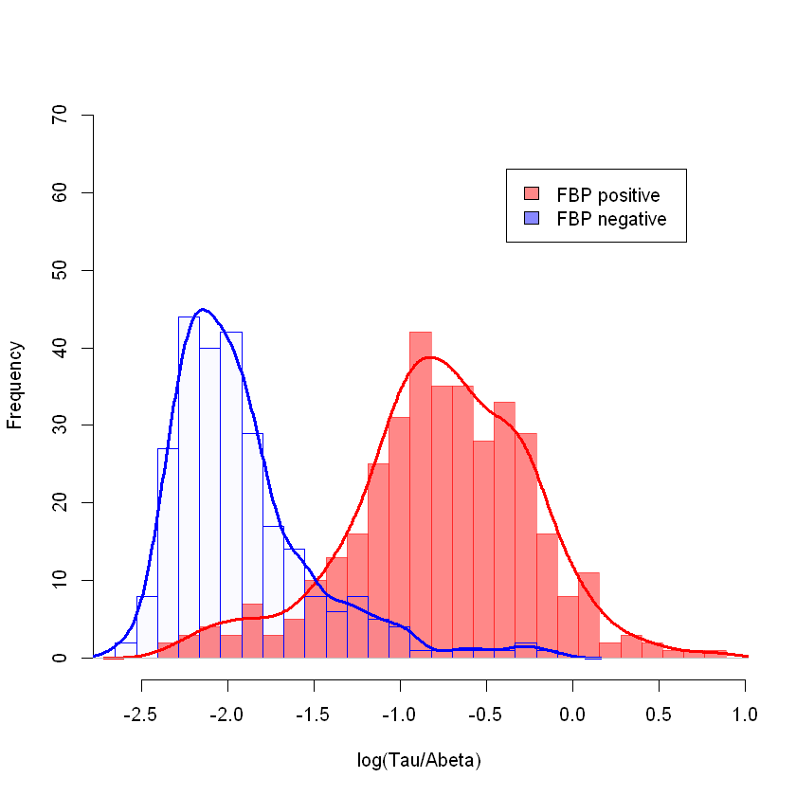
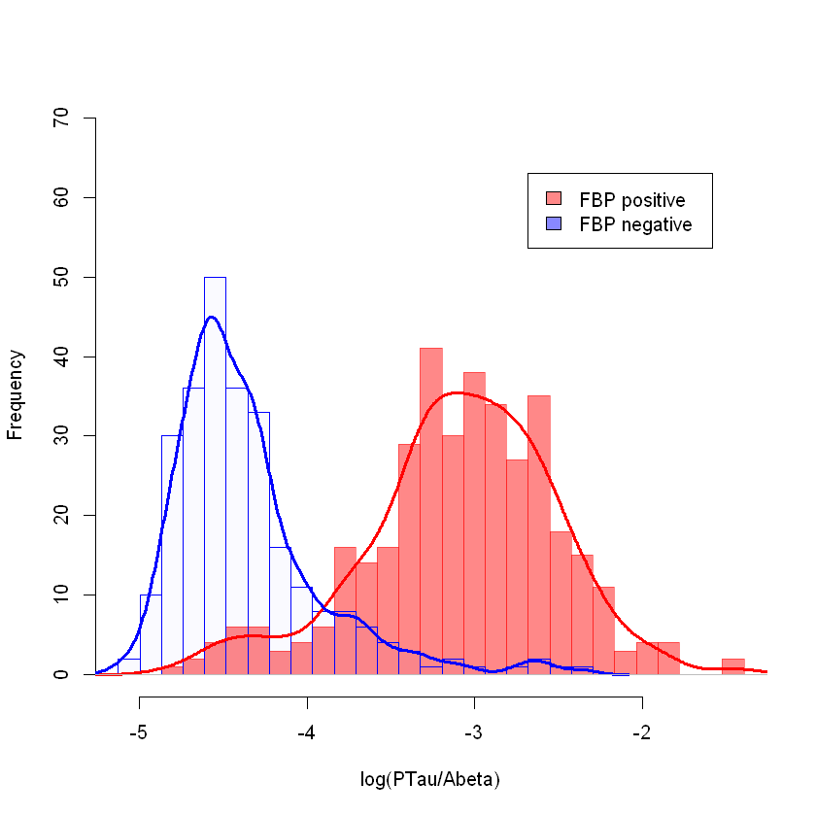
Frequency distribution plots: upper are mixture model plots, lower are FBP+ and FBP- for ADNI SMC/EMCI/LMCI/AD
Aβ₁₋₄₂
tau/Aβ₁₋₄₂
ptau₁₈₁/Aβ₁₋₄₂

Slide 11
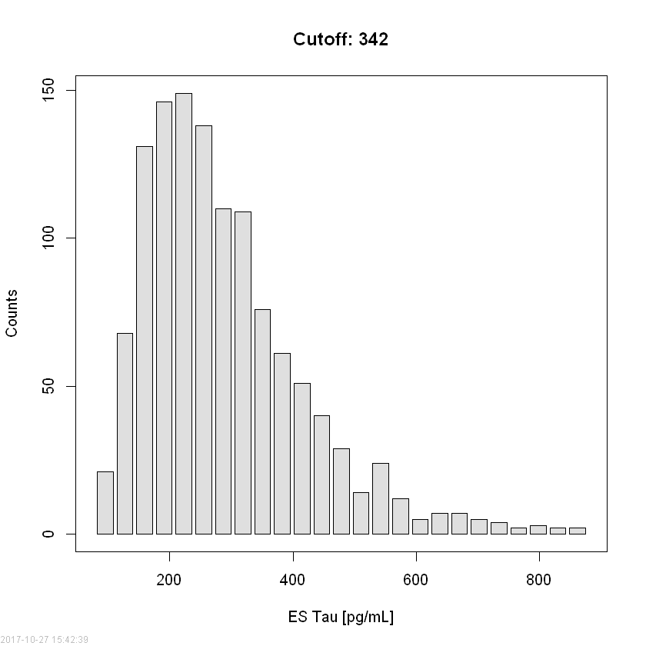
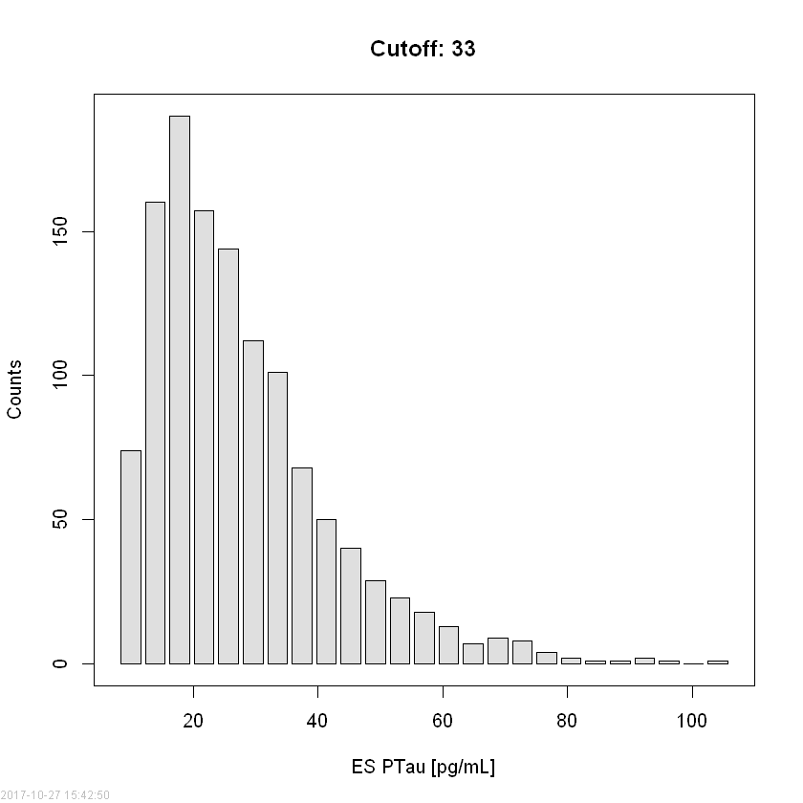
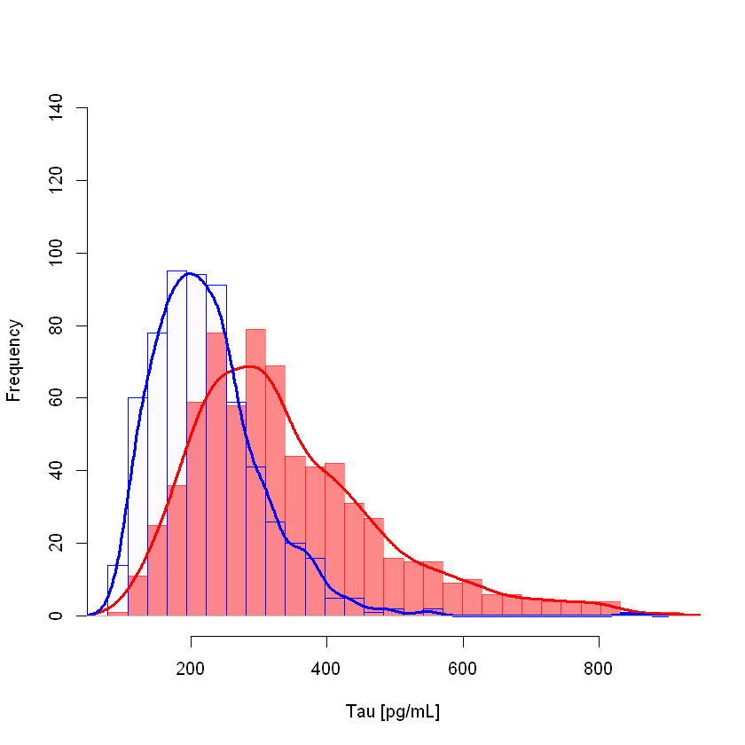
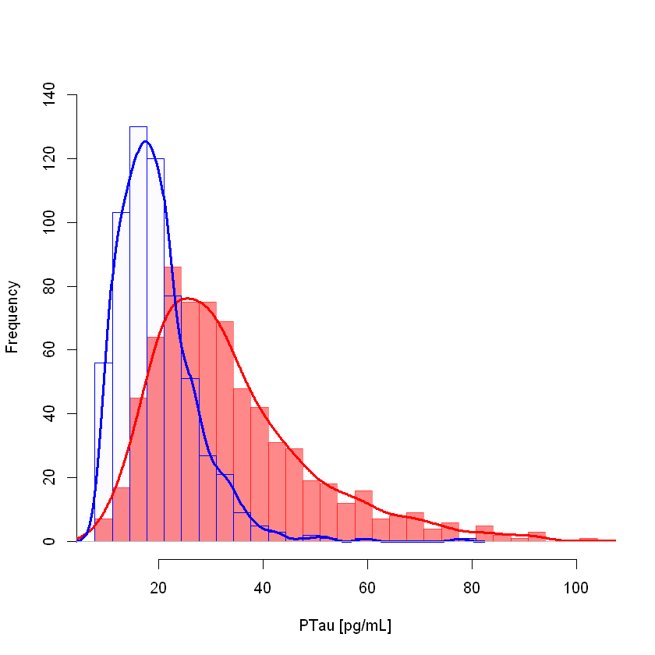
Frequency distribution plots: upper simple frequency plots, lower are FBP+ and FBP- for ADNI SMC/EMCI/LMCI/AD
aaaaaaaaaaaaaaaaaaaaaaaaaaaaaaaaaaaaaaaaaaaaaaaaaaaaaaaaaaaaaaaaaaa
tau
p-tau₁₈₁
FBP-
FBP+
FBP-
FBP+

Slide 12
Analyses of ADNI1/GO/2 CSF Aβ₁₋₄₂, t-tau, p-tau₁₈₁ using the Roche Elecsys fully automated immunoassay platform
In order to further address the question of what do CSF t-tau and p-tau₁₈₁ add to the clinical utilities of CSF Aβ₁₋₄₂ we describe the following analyses for the ADNIGO/2 EMCI+MCI participants:
Stratify into 4 sub-groups using Aβ₄₂ and either t-tau or p-tau₁₈₁
  Amyloid plaque burden +/- represented by Aβ₄₂+ or – : [Aβ+ or Aβ-]
  Tau pathology +/- represented by t-tau+ or - : [tau+ or tau-] or by p-tau₁₈₁+ or - : [p-tau+ or p-tau-]
Use the cut-points described in the previous ppt to determine + or – for each biomarker.
Test the hypothesis that having both Aβ+ & tau+ [ie, Aβ+/tau+ or Aβ+/p-tau+] is associated with much greater rates of cognitive, functional and memory decline as compared to having only one of the two pathologic states [ie, Aβ+/tau- or Aβ−/tau+].
Test the hypothesis that the least cognitive decline is associated with both classes of CSF biomarker being negative.
Test this also for risk for progression from a diagnosis of MCI to a diagnosis of AD dementia.

Slide 13
Rates of clinical decline as a function of Aβ42 and t-tau in ADNIGO/2 EMCI+LMCI
CDRsob
FAQ
Aβ+/tau+
Aβ+/tau+
Aβ+/tau+
MMSE
CDRsob
 | N | 2 yr change | Compare to Aβ-/tau- Δ 2yrs
Aβ-/tau- | 124 | -0.022 | --
Aβ-/tau+ | 42 | 0.048 | 0.070
Aβ+/tau- | 76 | 0.428 | 0.450
Aβ+/tau+ | 112 | 1.606 | 1.628
FAQ
 | N | 2 yr change | Compare to Aβ-/tau- Δ 2yrs
Aβ-/tau- | 124 | 0.664 | --
Aβ-/tau+ | 42 | 0.406 | -0.158
Aβ+/tau- | 76 | 1.422 | 0.758
Aβ+/tau+ | 112 | 4.052 | 3.388
MMSE
 | N | 2 yr change | Compare to Aβ-/tau- Δ 2yrs
Aβ-/tau- | 124 | -0.130 | --
Aβ-/tau+ | 42 | -0.404 | -0.274
Aβ+/tau- | 76 | -0.784 | -0.654
Aβ+/tau+ | 112 | -2.410 | -2.280

Slide 14
Rates of clinical decline as a function of Aβ42 and p-tau₁₈₁ in ADNIGO/2 EMCI+LMCI
CDRsob
FAQ
Aβ+/p-tau+
Aβ+/p-tau+
Aβ+/p-tau+
MMSE
CDRsob
 | N | 2 yr change | Compare to Aβ-/ptau- Δ 2yrs
Aβ-/ptau- | 124 | 0.036 | --
Aβ-/ptau+ | 42 | -0.116 | -0.080
Aβ+/ptau- | 76 | 0.358 | 0.322
Aβ+/ptau+ | 112 | 1.552 | 1.516
FAQ
 | N | 2 yr change | Compare to Aβ-/ptau- Δ 2yrs
Aβ-/ptau- | 124 | 0.654 | --
Aβ-/ptau+ | 42 | 0.534 | -0.120
Aβ+/ptau- | 76 | 1.366 | 0.712
Aβ+/ptau+ | 112 | 3.890 | 3.236
MMSE
 | N | 2 yr change | Compare to Aβ-/ptau- Δ 2yrs
Aβ-/ptau- | 124 | -0.136 | --
Aβ-/ptau+ | 42 | -0.312 | -0.176
Aβ+/ptau- | 76 | -0.804 | -0.668
Aβ+/ptau+ | 112 | -2.280 | -2.144

Slide 15
Characteristics of ADNIGO/2 E+LMCI for the study of Aβ₄₂/p-tau₁₈₁ combinations
 | Aβ₄₂-/p-tau₁₈₁- | Aβ₄₂-/p-tau₁₈₁+ | Aβ₄₂+/p-tau₁₈₁- | Aβ₄₂+/p-tau₁₈₁+
N | 139 | 60 | 87 | 145
APOE ε4, N(%) | 30(22%) | 21(35%) | 45(52%) | 109(75%)
Education, yrs | 16.3±2.6 | 16.2±2.4 | 16.1±2.7 | 16.2±2.7
Aβ₄₂, pg/mL | 1557±413 | 1612±618 | 689±176 | 672±159
p-tau₁₈₁, pg/mL | 16.4±3.8 | 33.1±13.3 | 16.4±4.4 | 39.1±13.8
t-tau, pg/mL | 191±44 | 350±111 | 178±43 | 382±124
tau/Aβ₄₂ | 0.13±0.03 | 0.25±0.14 | 0.28±0.12 | 0.60±0.25
p-tau/Aβ₄₂ | 0.011±0.0028 | 0.024±0.016 | 0.026±0.012 | 0.061±0.028
# progressors | 5 | 5 | 11 | 56
# non-progressors | 114 | 48 | 59 | 68
Drop-outs | 20 | 7 | 17 | 21

Slide 16
Characteristics of ADNIGO/2 E+LMCI for the study of Aβ₄₂/t-tau combinations
 | Aβ₄₂-/t-tau- | Aβ₄₂-/t-tau+ | Aβ₄₂+/t-tau- | Aβ₄₂+/t-tau+
N | 154 | 45 | 116 | 116
APOE ε4, N(%) | 34(22%) | 17(38%) | 64(55%) | 90(78%)
Education, yrs | 16.2±2.6 | 16.3±2.4 | 16.2±2.8 | 16.1±2.7
Aβ₄₂, pg/mL | 1578±433 | 1559±631 | 666±173 | 692±157
p-tau₁₈₁, pg/mL | 17.2±4.4 | 36.9±14.3 | 18.8±5.7 | 42.4±13.5
t-tau, pg/mL | 198±48 | 378±115 | 197±51 | 414±119
tau/Aβ₄₂ | 0.13±0.04 | 0.28±0.14 | 0.33±0.14 | 0.64±0.26
p-tau/Aβ₄₂ | 0.011±0.0034 | 0.027±0.017 | 0.031±0.015 | 0.065±0.029
Progressors | 6 | 4 | 18 | 49
Non-progressors | 127 | 35 | 74 | 53
Drop-outs | 21 | 6 | 24 | 14

Slide 17
Cox proportional-hazards analyses: comparisons across
CSF t-tau (+ or –) combined with Aβ42 (+ or -)
Hazard ratios:
Aβ42-/t-tau+ 1.68(0.627 -- 4.50)
Aβ42+/t-tau- 2.80(1.17 -- 6.67)
Aβ42+/t-tau+ 9.23(4.15 -- 20.5)
Cox proportional hazards models adjusted
for gender, age, education years and APOE
ε4 allele #.

Slide 18
Cox proportional-hazards analyses: comparisons across
CSF p-tau₁₈₁ (+ or –) combined with Aβ42 (+ or -)
Hazard ratios:
Aβ42-/p-tau+ 1.41(0.521 -- 3.79)
Aβ42+/p-tau- 2.46(1.04 -- 5.84)
Aβ42+/p-tau+ 7.85(3.67 -- 16.8)
Cox proportional hazards models adjusted
for gender, age, education years and APOE
ε4 allele #.

Slide 19
ACKNOWLEDGEMENTS
Biomarker Research Lab
Magdalena Korecka
Michal Figurski
Magdalena Brylska
Teresa Waligorska
Leona Fields
Jacob Alexander
Ju Hee Kang
CNDR/ADRC
John Trojanowski
Virginia M-Y Lee
Steve Arnold
David Irwin
Murray Grossman
Jon Toledo
Alice Chen-Plotkin
William Hu
Anne Fagan
Hugo Vanderstichele
Kaj Blennow
Henrik Zetterberg
Douglas Galasko
Chris Clark*
Manu Vandijck
John Lawson
Udo Eichenlaub
Tobias Bittner
The Roche team
*Deceased
Robert Dean
Holly Soares
Adam Simon
Eric Siemers
Piotr Lewczuk
William Potter
Rand Jenkins
Erin Chambers
Supported by the NIH/NIA & families
of our patients
MJ Fox Fdn for PD research
ADNI investigators include: (complete listing available at www.loni.usc.edu\ADNI\ Collaboration\ADNI_Manuscript_Citations.pdf

